Slide 1



Lecture-2 Installation By: Naveen Tiwari
LINUX ADMINISTRATION
1

Slide 2

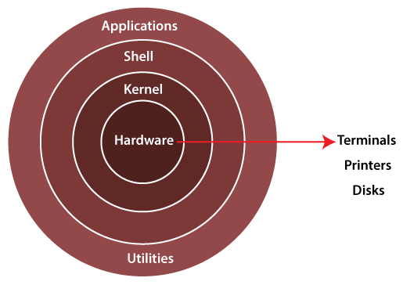

Linux Architecture

Slide 3
Linux Architecture
Hardware layer
Hardware consists of all peripheral devices. Eg - RAM/ HDD/ CPU/ Printer etc.
Kernel
It is the core component of Operating System.
Interacts directly with hardware.
Provides low level services to upper layer components.

Slide 4
Shell
An interface to kernel, hiding complexity of kernel's functions from users.
The shell takes commands from the user and executes kernel's functions.
Utilities
Utility programs that provide the user most of the functionalities of an operating systems.

Slide 5
Linux Installation

Slide 6
Linux file-system
A file system is an architecture defining how files are stored and retrieved.
For OS, a file system may be defined as a hard disk, flash memory, RAM, or optical discs.
Linux file system has a hierarchal file structure as it contains a root directory and its subdirectories.
All the files are arranged as a tree and its branches.
The topmost directory called the root (/) directory.

Slide 7
The architecture of a File System
A file system mainly consists of 3 layers :
1. Logical file system
Interacts with the user application with the help of an API to provide open, read, close etc.
2. Virtual file system:
Enables multiple instances of the physical file system to run concurrently.
3. Physical file system
Handles the physical aspect of the disk while managing and storing physical memory blocks being read and written.

Slide 8
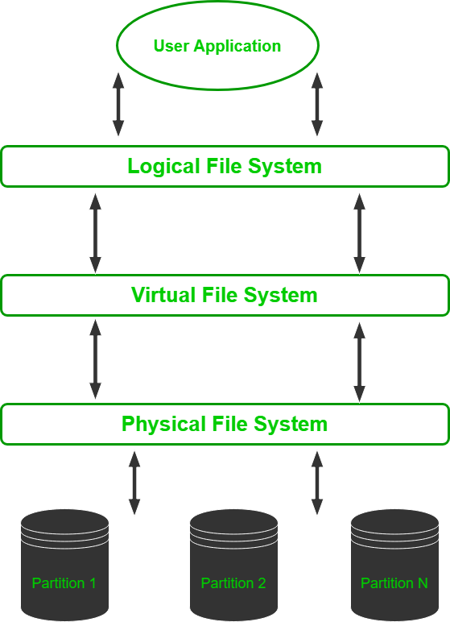
The architecture of a File System

Slide 9
Linux File System Features
Specifying paths
Linux does not use the backslash (\) to separate the components.
it uses forward slash (/).
Eg :
Partition, Directories, and Drives
Linux, we cannot tell whether we are addressing a partition, a network device, or an "ordinary" directory and a Drive.
Case Sensitivity
Linux file system is case sensitive.
Eg :

Slide 10
File Extensions
In Linux, a file may have the extension.
Eg :
Hidden files
Linux distinguishes between standard files and hidden files.
Mostly the configuration files are hidden in Linux OS.
Eg:
Metadata
The file system stores various information.
Eg:
Utilities
File systems provide features for initializing, deleting, renaming, moving, copying, backup, recovery, and control access of files and folders.

Slide 11
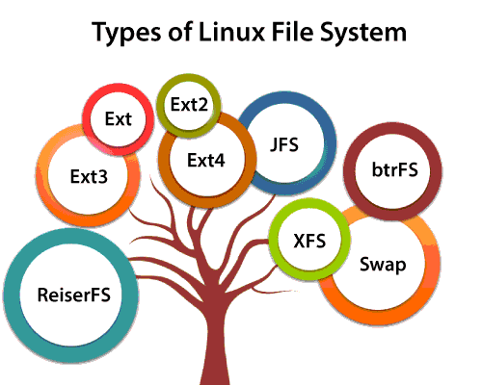
Types of Linux File System

Slide 12
Types of Linux File System
ext (Extended File System)
Eg :
JFS (Journaled File System)
ReiserFS
XFS
SquashFS
Reiser4
btrfs (Better/Butter/B-tree FS)
Bcachefs
Swap File System
Others

Slide 13
Journaling
Journaling file systems keep a log called the journal.
It keeps a track of the changes made to a file but not yet permanently committed to the disk so that in case of a system failure the changes lost can be brought back.
Versioning
Versioning file systems store previously saved versions of a file.
The copies of a file is stored based on previous commits to the disk in a minutely or hourly manner to create a backup.
Inode
The index node is the representation of any file or directory based on the parameters – size, permission, ownership, and location of the file and directory.
root directory inode no. 2
lost+found directory inode no. 3.
Inode numbers 0 and 1 are not used.

Slide 14
Boot process
The machine’s BIOS or boot microcode hundreds and runs a boot loader.
2. Boot loader finds the kernel image on the disk and loads it into memory, to start the system.
3. The kernel initializes the devices and their drivers.
4. The kernel mounts the basis filesystem.

Slide 15
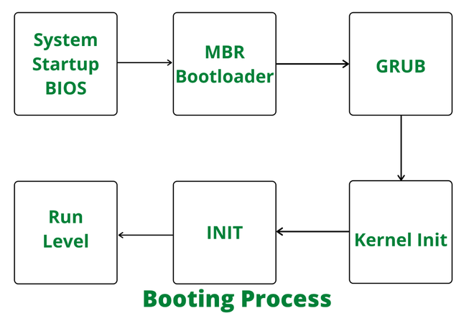
5. The kernel starts a program referred to as init with a method ID zero.
6. init sets the remainder of the system processes in motion.
7.For some purpose, init starts a method permitting you to log in, typically at the top or close to the top of the boot sequence.

Slide 16
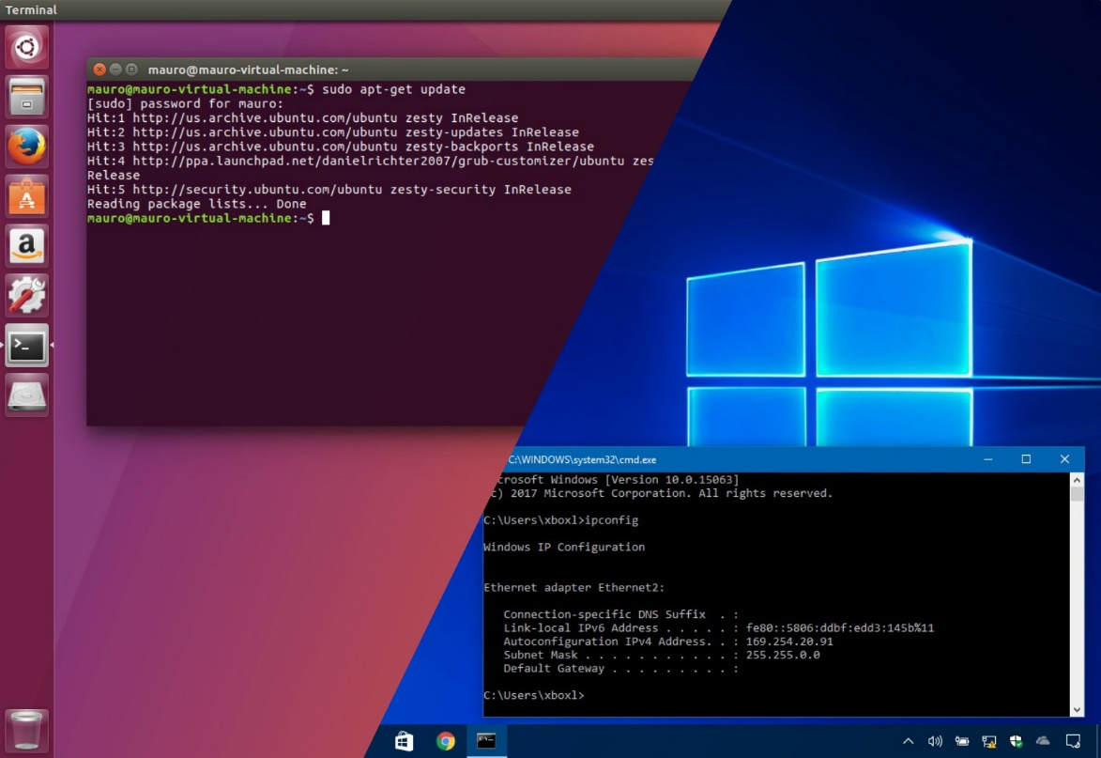
Dual boot
Dual booting is a way of using two or more different operating systems (OS) on a single computer.
Each operating system is installed on a separate "partition" on the main hard drive.

